Slide 1


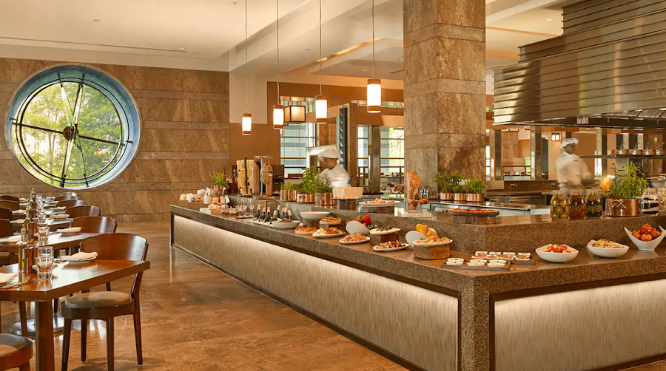

Mentorness Internship Project
On,
Restaurant Rating Prediction
By,
Shobha Kumari Choudhary
Notes:
Hello all, myself Shobha kumari Choudhary. As a part of Mentorness internship program I have build a machine learning project on Restaurant rating prediction. This is a supervised machine learning Regression problem aims at finding the factors that increases aggregate ratings of the restaurants.

Slide 2




Today’s Agenda
Problem Statement
Dataset Preview
Exploratory Data Analysis
Model Building Approach
Model Comparison
Feature Importance
Insights & Recommendations
Notes:
Today, Agenda outlines all the steps involved in completing my internship projects , these includes - PS that is predicting the restaurant ratings, then I will give preview on dataset, then I will talk about EDA part and uncover some useful insights , then I will discuss the modelling approach used and then I will compare the models built based on accuracy score, and then will discuss the optimal model . And lastly i will give business insights & recommendations.

Slide 3

Problem Statement
Develop a machine learning model to predict the aggregate rating of a restaurant based on various features related to the restaurant's characteristics and operations.
Notes:
Machine learning is a challenging task when predicting restaurant ratings. The number of restaurants opening every day is increasing. Their competition with already established restaurants has become increasingly difficult. It is mainly due to the subjective nature of restaurant ratings, which depend on many factors, including the reviewer’s preferences, the quality of the food, the ambiance, and the overall service of the restaurant.
We will use machine learning to explore how restaurant ratings can be accurately predicted

Slide 4
Dataset preview
Restaurant ID: Unique identifier for each restaurant.
Restaurant Name: Name of the restaurant.
Country Code: Numeric code representing the country where the
restaurant is located.
City: Name of the city where the restaurant is situated.
Address: Physical address of the restaurant.
Locality: Locality or neighborhood where the restaurant is located.
Locality Verbose: Detailed description of the locality.
Longitude: Geographical longitude of the restaurant's location.
Latitude: Geographical latitude of the restaurant's location.
Cuisines: Types of cuisines offered by the restaurant.
Average Cost for Two: Average cost for a meal for two people.
Currency: Currency used for transactions in the restaurant.
Has Table Booking: Indicator of whether the restaurant accepts table bookings.
Has Online Delivery: Indicator of whether the restaurant offers online delivery.
Is Delivering Now: Indicator of whether the restaurant is currently delivering.
Switch to Order Menu: Indicator of whether the restaurant has switched to an order menu.
Price Range: Price range category of the restaurant.
Aggregate Rating: Overall rating of the restaurant.
Rating Color: Color code representing the rating.
Rating Text: Text description of the rating.
Votes: Number of votes received by the restaurant.
Overview of the Datasets
Our Dataset Contains various information related to Restaurants that can help in Predicting the Aggregate Ratings based on Various Features.
The Features Include
Notes:
The dataset contains all the reviews for the restaurants from customers. We will use machine learning models for restaurant to predict its rating. Several parameters need to be considered when predicting ratings, such as the average cost for two people, the availability of online ordering, foods, menu items, and most popular dishes.

Slide 5
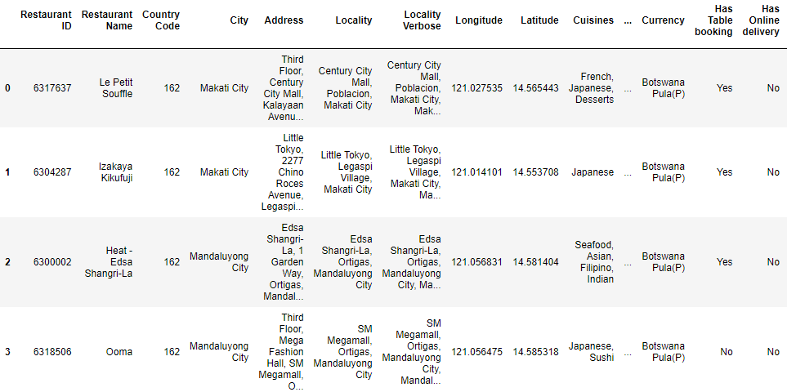
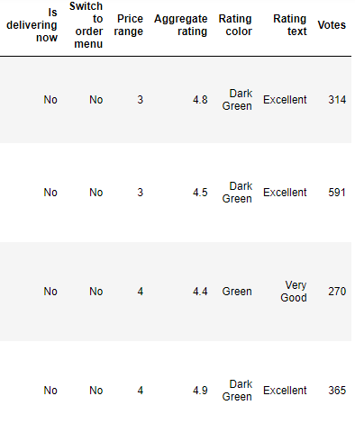
Data Ingestion
Sample of the Dataset
Dataset Contains 9551 rows & 21 columns.
No Duplicate rows present.
Few Null values are present in the dataset.
Outliers are there in various features.

Slide 6
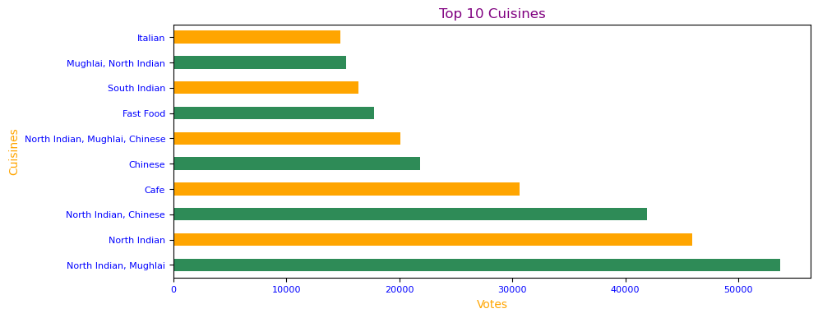
Exploratory data Analysis
These are the Top 10 Cuisines based on Number of Votes
Notes:
Eda is very important steps that is performed before any model building. It gives detailed explanations of the datasets , their features, trends , patterns present etc.
For any restaurant Cuisines is very important feature . While performing eda on cuisine I found these Top 10 cuisines based on votes these are :

Slide 7
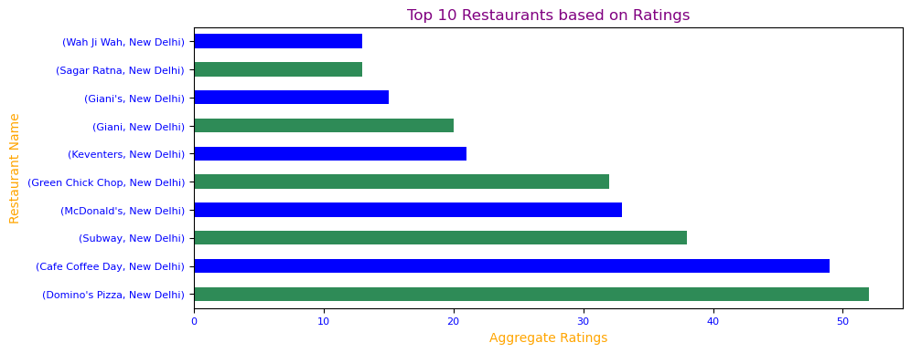
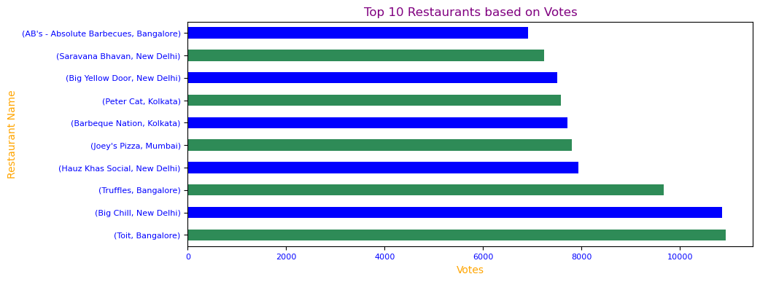
Exploratory data Analysis
These are the Top 10 Restaurants based on Ratings
All these restaurants belongs to New Delhi
These are the Top 10 Restaurants based on Number of Votes.
All these restaurants belongs to India only.
Notes:
On exploring column Restaurants names , based on ratings I found these top 10 restaurants that all belongs to city new Delhi .
and based on number of votes the top 10 restaurants are Toit Bangalore , Big Chill New Delhi ,Truffles Bangalore , Hauz Khas Social New Delhi, Joey's Pizza Mumbai, Barbeque Nation Kolkata ,Peter Cat Kolkata, Big Yellow Door New Delhi , Saravana Bhavan New Delhi , AB's - Absolute Barbecues Bangalore .
These all restaurants also belongs to country India.

Slide 8
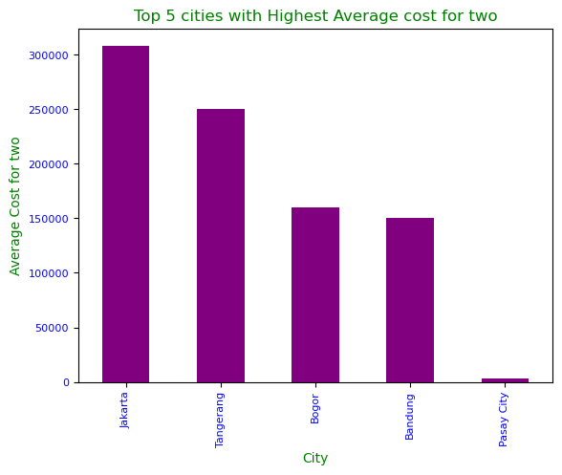
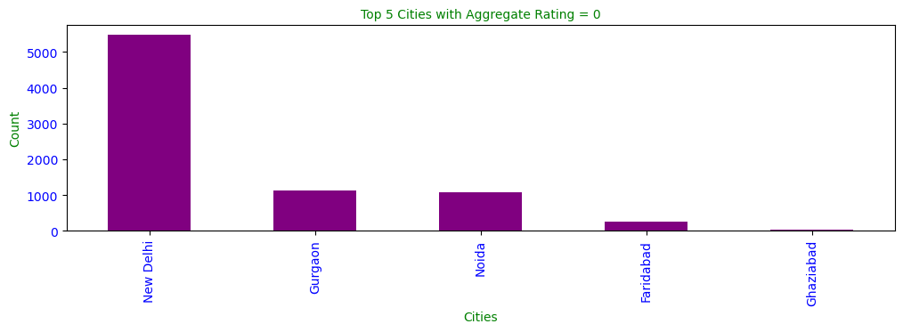
Exploratory data Analysis
Expensive Restaurants mostly belongs to City Jakarta with mean of avg cost more than 300000.
Maximum No of Zero Ratings are from the Indian Customers.
Country code – 1 belongs to Indian Cities.
Notes:
Based on avg cost for two the top 5 expensive cities are Jakarta , Tangerang, Bogor , Bandung , Pasay City with the mean of avg cost more than 50,000. to 3 lakh.
Also, there are some restaurants with aggregate rating equals to zero. Maximum no zero ratings are from Indian customers and the city includes new Delhi, Gurgaon, Noida, Faridabad & Ghaziabad.

Slide 9
Model Building Approach
Data Cleaning
Data Encoding
Data Transformation
Train - Test Split
Model Building
Model Validation
Notes:
1. Data is cleaned for any Anomalies present in the dataset.
Null values, Outlier Treatment, incorrect Datatype mapping were all done using Appropriate methods.
2. All the Categorical columns were Encoded using Dummy Encoding.
Model building Algorithm can’t handle Categorical data, so we need to convert into encoded integers.
3. Features are Transformed (Scaled) using MinMax Scalar.
4. Train – Test split is done using the 70 : 30 ratio.
5. Built various models and checked Accuracy against the Test data.
Done Hyper-parameter Tuning to get Better Accuracy and Generalized models.
6. Model is validated using R2 and Adj. R2.

Slide 10
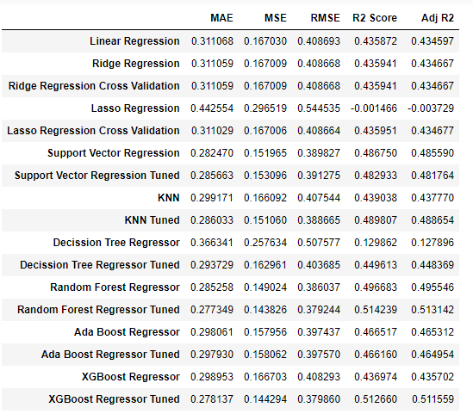
Model Comparison
Most Optimal Model
XGBoost Regressor Tuned Model is the Most Optimal Model.
Accuracy of this Model is 51%.
R2 and Adj. R2 both are Same.
Notes:
The various models built by training the features of the dataset with different ML algorithms were tested, and their performances were compared.
various ML models built are Linear Regression (LR), Decision Tree (DT), Random Forest (RF), Support Vector Machine (SVM), SVM with grid search (SVMG), K-Nearest Neighbour (KNN) , ada boost & XGBoost. The highest performance was obtained for the XGBoost model.

Slide 11
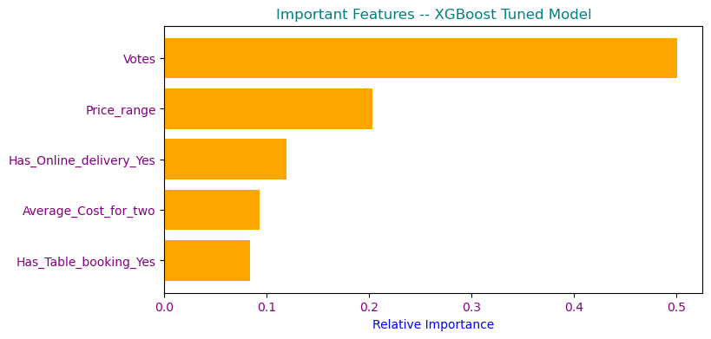
Feature Importance
The Important features that are useful for predicting the Aggregate Rating of Restaurants are :
Votes
Price Range
Has Online Delivery
Average Cost for Two
Has Table Booking.

Slide 12

Insights & Recommendations
XGBoost Regressor Tuned Model is good generalized model with R-Square(R2) and Adj. R2 of 51% score.
The Important features that are helpful in predicting the Aggregate ratings of the restaurants are : Votes, Price range, Has online delivery, Average cost for two and Has table booking.
The restaurants should make sure that they provide more services like online delivery, table booking facility to increases their Ratings.

Slide 13

Thank You

